Slide 1
HOME PAGE
WALLPAPER TO BE CHANGED
Welcome to Actice7
Thinking Big for All
There's much to see here. So, take your time, look around, and learn all there is to know about us. We hope you enjoy our site and take a moment to drop us a line.
Let’s try the Best
Join now

Slide 2
News
New Year Offer
Offer : Cashback offer on Joining up to Rs 150/-*
Reaching : lvl-3 Amazon Coupons Rs -100/-*
Valid till : 31/ Jan/2019
* Terms & Condition as aplicaple

Slide 3
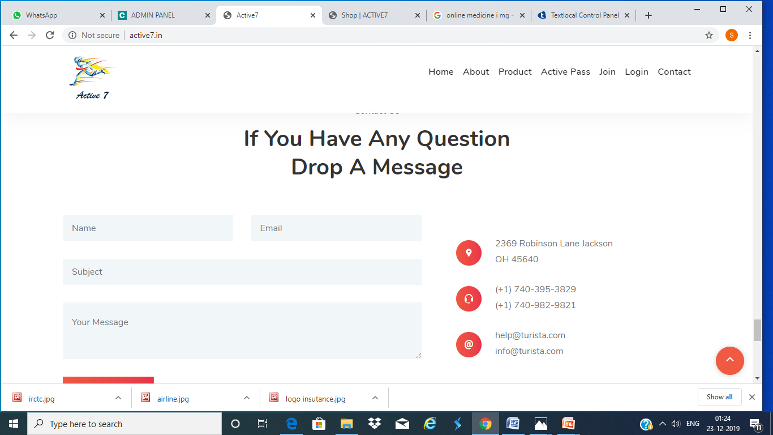
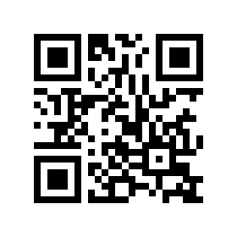
CONTACT
Message qr qode
IF YOU HAVE ANY SERVICE REQUEST
DROP A MASSAGE
NAME PHONE NO
EMAIL
191 G.T.ROAD Burdwan 713101
Ph -7319343444
support@active7.in

Slide 4
About
Active Seven is a concept that we brought to you for the first time.We do not know if anyone has heard or heard of this concept before. During this time, our country has come a long way towards digitalization.This digitalization our strength is our service to us everything.We want all the people of the country to go for digitalization.We want all the people of the country to be aware of this digitalization and take its benefits regularly. We know that many people in the country are not yet aware of digitalization .Our question? to you is why you are still lacking in digitalization
All the services we provide through digitalization. Hopefully through our service you will be aware of digitalization. We offer this service in exchange for a small amount of Service fee .
Active Seven always think about Consumers benefit. Active Seven provide a customer Refferal Program. We Provide Service at your doorsteps. We are a group of people who are well-versed in the fun and rigors of traveling. Our travel agency came together to help other people plan and book their dream vacations. While working with us, we want you to be completely happy with the experience. If you have questions about us, our services, or even travel tips, get in touch! We hope you continue to book with us for many years to come.

Slide 5
Services
HOW TO AVAIL THE SERVICE
Hotel Booking {International and Domestic
Flight booking
Train tickets
Holiday Package {International and Domestic)
General Insurance(upto 5% Off)
Life insurance (upto 5%off)
Prescribed Medicine (up to @25%off via Third party)
Home Loan Assistance
Business loan Assistance
Event Management Service
Online application (Passport /Pan Card)
Business Project Report (Dpr)
Car Rental (at Low Cost)
Electricity Bill Payment (1 %off)
Interior Decoration
Elecritician Service
Repairs and Services of Electrical Items
Mobile, Landline, Dth, recharge are also available
Rs- 100 + 18% GST = Rs 118.00
Service charges for Consaltation fee of 18 Service listed for duration of 1 year
We Promise to provide Best Service Product At Low Cost
Customer May Register for Reward Program
All Services provided By Respective Companys
Service request to be attended within 24hrs
Service fee is not refundable.
ANY TYPE OF SERVICE REQUIRMEMT
WHATAPP US on 7319343444
From register Mobile Number
EXAMPLE
HOTEL BOOKING
SEND
OR
Sms
Go to write Message Option
Type : FCEH4 <space> Flight or Service you Required
Send to
+919220592205
WE WILL GET BACK TO YOU SHORTLY
Service Charge

Slide 6
Active Seven Pass
Active Seven Pass is Reward to Costumer for ther continous Support for our company. Customer Can Avail this reward program at thier own decision. This program will not cost extra to Customer.
For activating Active seven Pass Customer have to refer three Customer to us and sit back and enjoy this program .
Active 7 Pass (OPTION1)
Active 7 Pass (OPTION2)
ANDAMAN TOUR
5DAYS 4 NIGHT
FLIGHT(7KG LUGGAGE)
HOTEL (3STAR)
SIGHTSEEN
TRANSPORT(AC)
FOOD(BREAKFAST LUNCH & DINNER)
EX KOLKATA
THAILAND TOUR
5DAYS 4 NIGHT
FLIGHT(7KG LUGGAGE)
HOTEL (3STAR)
SIGHTSEEN
TRANSPORT(AC)
FOOD(BREAKFAST LUNCH & DINNER)
EX KOLKATA
TERMS AND CONDITION
Journey offer date are to be fixed by company within three month of active7 pass Issue with two optional date
For International journey Passport Required and visa as applicable with norms of foriegn countries extra
Hotel rooms on twin Sharing Basis
Activepass can be transfered or Gift to anybody by the Member
For Extention of of any tour program Kindly Contact Customer Support
Active seven pass to be awarded in Lvl 7
Level detial to be seen in our website 24/7
Active7 reward program is only for the Customer availing our Service

Slide 7
MESSAGE QR CODE

Slide 8

WE WORK WITH

Slide 9
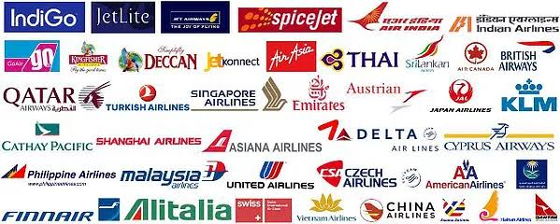

Slide 10
DETIALS ITENARRY

Slide 11
Andaman 5 days 4 night
DAY 1
Arrive Port Blair:
From kolkata Airport On arrive at Port Blair airport, our representative will receive and escort to the hotel. After check-in at the hotel and a little relax, we proceed to Cellular Jail (National Memorial). At evening, we move for the Light and Sound Show at Cellular Jail where the saga of the freedom struggle brought alive.
DAY2
Today, we start our journey towards Havelock Island via ferry from Port Blair Harbor. On arrival at Havelock Island, our representative will receive and escort you to check-in to the resort. After relax, proceed to Radhanagar Beach (Beach No. 7), the Times Magazine rated the finest beach among the best beaches in Asia. It is an ideal place for swimming, sea bathing and basking on the sun-kissed the beach
DAY 3
Today morning proceed to Elephant Beach by sharing a boat, 1 session of Snorkeling complimentary for all pax. (Subject to operation).
Note: If Elephant Beach is not operational the guest would be taken to Kalapathar Beach.
DAY 4
oday Check out from Havelock Island & proceed back towards Port Blair (via ferry).
Shopping: At evening, we proceed to Sagarika ( the Govt. Emporium of Handcraft) and local market for shopping.
DAY5
Depart From Andaman Island:
Proceed to the airport as this fantastic tour comes to an end. Return home with wonderful memories of your tour with Active7..

Slide 12
Thailand 5 days 4 night
DAY 1
“Welcome to Thailand. On arrival in Bangkok, you will be greeted by your friendly local representative outside the baggage hall area at the airport. (At Swarnabhoomi Airport GATE 10C; At DMK airport Gate 1 ) Sit back in the comfort of your coach, drive to the beautiful beach destination – Pattaya which lies about 150-km southeast of Bangkok. On arrival in Pattaya check into your hotel and relax (Standard Check in time after 1500Hrs). This evening proceeds to visit the Colosseum/Alcazar Show Pattaya, Thailand’s latest, largest and most spectacular cabaret show.
DAY2
Today after an American breakfast at the hotel get set to explore the charm and beauty of Coral Island (subject to weather condition). Start with an exciting ride in a speedboat to the Island, En route we shall stop at a pontoon where you have an option of experiencing parasailing (on your own). Next stop an option of experiencing Underwater Sea Walk (on your own). Once we reach the Island here you can enjoy various water-sports activities like banana boat ride, jet ski, swimming in the tropical water, etc. on your own (Do not forget to carry your swimwear).
DAY 3
Today after an American breakfast at the hotel, check out and drive to the capital city - Bangkok.
Chance to enjoy a fun-filled with sky trian along with free time at Indra market/ MBK shopping center
(at an additional cost):
.
DAY 4
Today after an American breakfast at your hotel, day free at leisure OR get a chance to experience some adventure at Thailand’s greatest open-air zoo and Leisure Park. Whether it is an exciting safari drive through the picturesque African wilderness setting in the open zoo, an intimate encounter with the friendly dolphins and playful sea lions or an exhilarating fast-paced action stunt, spectacular Safari World has it all. Enjoy Indian Lunch at Marine Park for all who opt for an optional excursion. A drive through the scenic Safari Park presents a unique opportunity for the closest encounter possible with rare and endangered species of the animal kingdom. .
Day5
Today after an American breakfast at your hotel, proceed to the airport as this fantastic tour comes to an end. Return home with wonderful memories of your tour with Active7.

Slide 13
BALI (COMMING SOON)
Sols.webtech@gmail.com

